Slide 1
Forecasting Hotel Reservation Cancellations- A Machine Learning Approach
PGPDSE CHN JAN23(Group-2)
Final Presentation
Presented by,
Praveen Arokia Raj A
Harishri Karthikeyan
Sathish J
Balachandar P
Raghav G
Mohana Devan R
Guided by,
Mr.Jayveer Nanda

Slide 2
OBJECTIVE AND SCOPE
Project Objective:
The Business objective for the Hotel Reservations Cancellation Prediction includes maximizing revenue, improving customer satisfaction , reducing cancellations and streamline operations.
Problem Statement:
To Predict the booking status(cancelled or not cancelled) from a classification dataset(Hotel Reservation Cancellation Prediction).
Scope:
The goal is to improve the overall guest experience while optimizing operations for maximum success and minimize losses .
Challenges:
To develop a reliable model that can help hotel management to identify potential cancellations in advance and take appropriate measures to reduce the impact on their business.

Slide 3
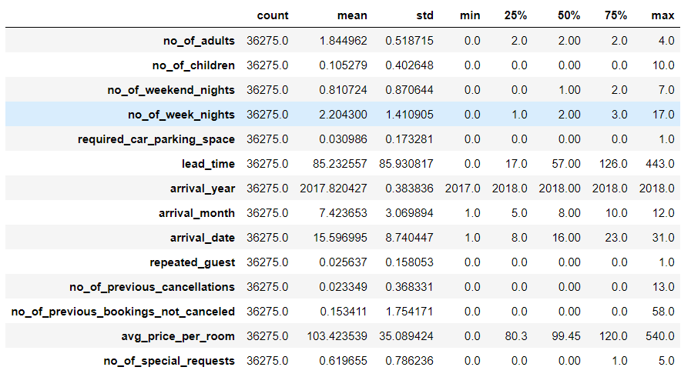
EXPLORATORY DATA ANALYSIS
Data Understanding:
From the Hotel Reservation Dataset there are 36275 instances and 19 attributes and
There are 8 numerical attributes and 11 categorical attributes including the dependent variable.
Five point Summary Statistics:
The Five point summary statistics is done for the numeric and categorical attributes.
where we can infer the basic statistics like average (mean, median, count) and the max and min values

Slide 4
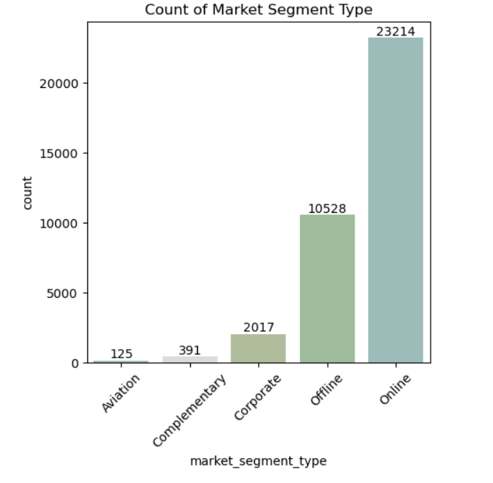
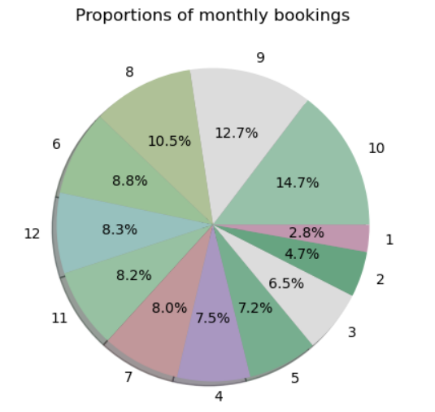
Univariate Analysis
There are no missing values in the dataset
Features eliminated:
Booking ID, Arrival year.
Month of Arrival and the Mode of Booking:
It is clearly evident that we have majority of the bookings are in the month of August, September and October.
Online mode has the most of all bookings.
Notes:
From the above univariate analysis, it is clearly evident that the business is season driven and also mostly on the online mode.

Slide 5
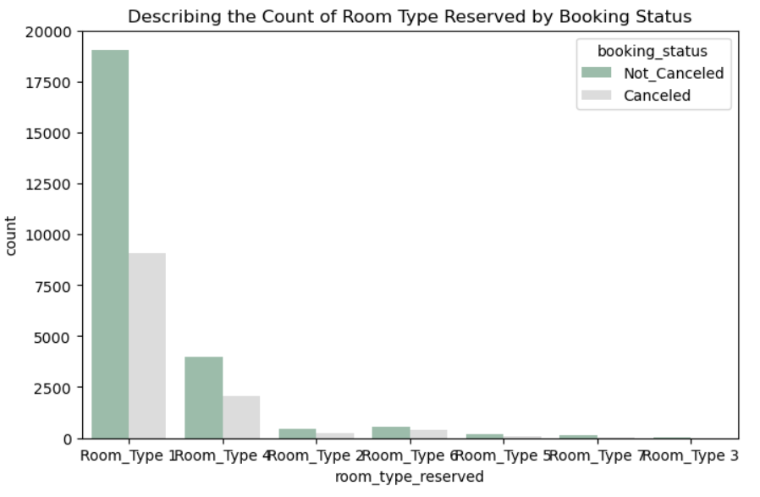
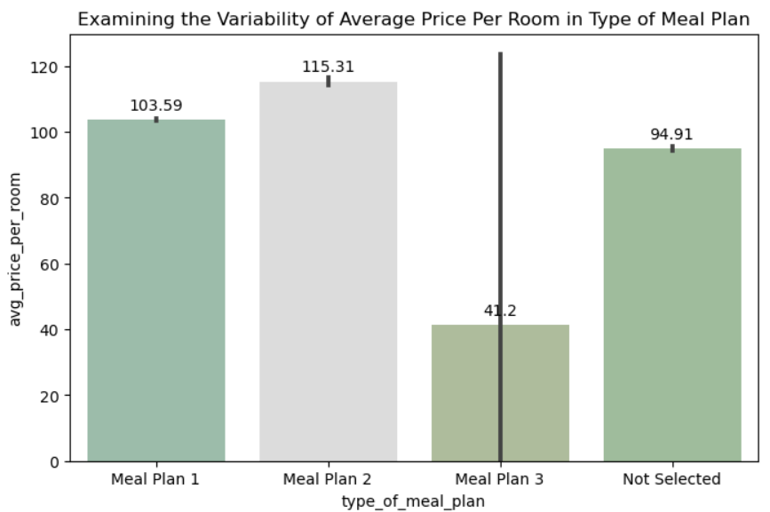
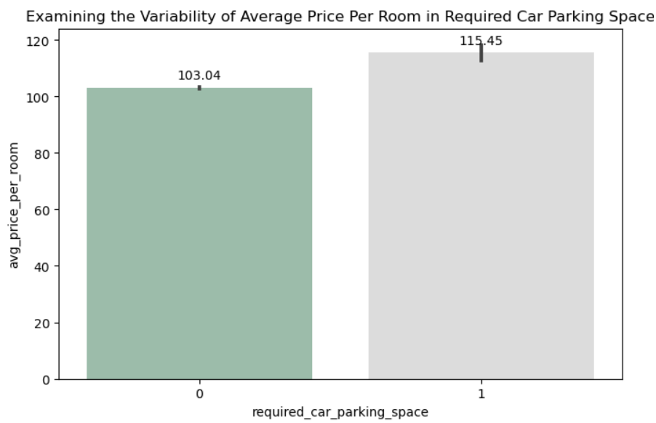
BIVARIATE ANALYSIS
Notes:
Room type 1 is the most preferred, while meal plan stands unselected to a sizeable proportion of time.

Slide 6
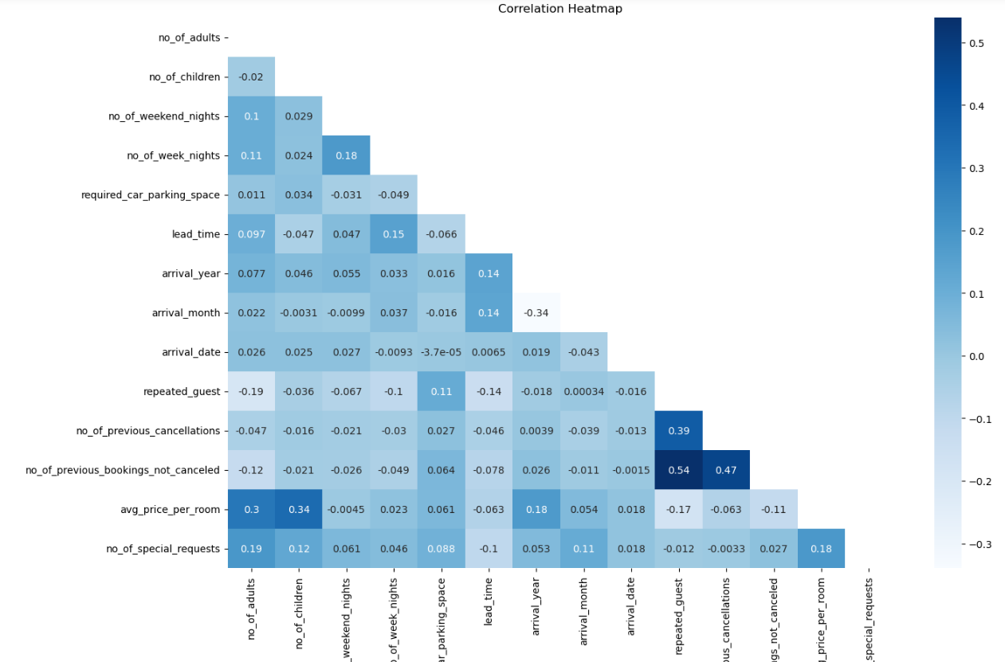
From the correlation matrix it is found that not much of the independent variable has correlation with each other.
2) Hence no multicollinearity in between the predictor variables.
3) Highest correlation exist between "no of previous bookings not cancelled” with “repeated guest” and “guest not cancelled”
Notes:
After the basic model was built VIF was tested for the independent variable, which revealed no multicollinearity.

Slide 7
STATISTICAL ANALYSIS
Testing the relationship of every feature with the predicted variable using statistical tests
S.No | Statistical Test | Type of Variables | Feature Name | P Val | Inference
1 | f_oneway | Num Vs Cat | no_of_adults | 0 | Significant
2 | f_oneway | Num Vs Cat | no_of_children | 0 | Significant
3 | f_oneway | Num Vs Cat | no_of_weekend_nights | 0 | Significant
4 | f_oneway | Num Vs Cat | no_of_week_nights | 0 | Significant
5 | chi2_contingency | Cat Vs Cat | type_of_meal_plan | 0 | Significant
6 | chi2_contingency | Cat Vs Cat | required_car_parking_space | 0 | Significant
7 | chi2_contingency | Cat Vs Cat | room_type_reserved | 0 | Significant
8 | f_oneway | Num Vs Cat | lead_time | 0 | Significant
9 | chi2_contingency | Cat Vs Cat | market_segment_type | 0 | Significant
10 | chi2_contingency | Cat Vs Cat | repeated_guest | 0 | Significant
11 | f_oneway | Num Vs Cat | no_of_prev_cancellations | 0 | Significant
12 | f_oneway | Num Vs Cat | no_of_prev_bookings_not_canceled | 0 | Significant
13 | f_oneway | Num Vs Cat | avg_price_per_room | 0 | Significant
14 | f_oneway | Num Vs Cat | no_of_special_requests | 0 | Significant
1) From above performed statistical tests we can conclude that none of the columns has failed to reject null hypotheses which means none of the columns are insignificant to the target variable booking status.
2) At this stage we cant drop any variable. On further progress after building few models and checking for their metrics if the performance is considerably low we can drop some columns based on the feature importance score.

Slide 8
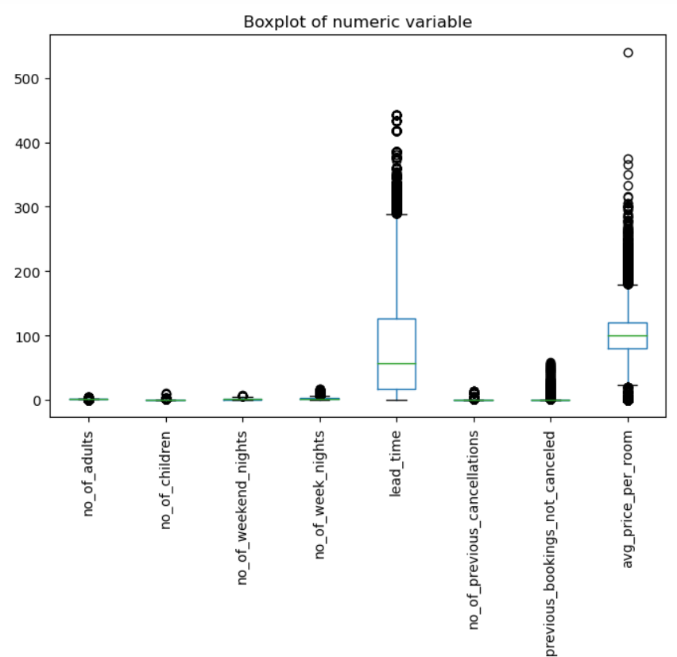
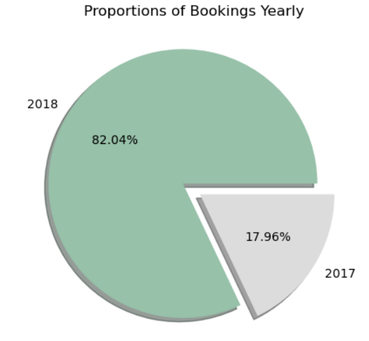
EXPLORATION AND ANALYSIS FOR OUTLIER TREATMENT
Most of the numerical variable has outliers and are skewed. Since IQR treatment will result in loss of data, we choose to perform power transformation for the data to treat the skewness before introducing the data to the model.
Challenges Addressed:
Class Imbalance in the Target Variable:
This was addressed by smoting technique
Outlier Treatment for the numerical variable :
Power Transformation

Slide 9
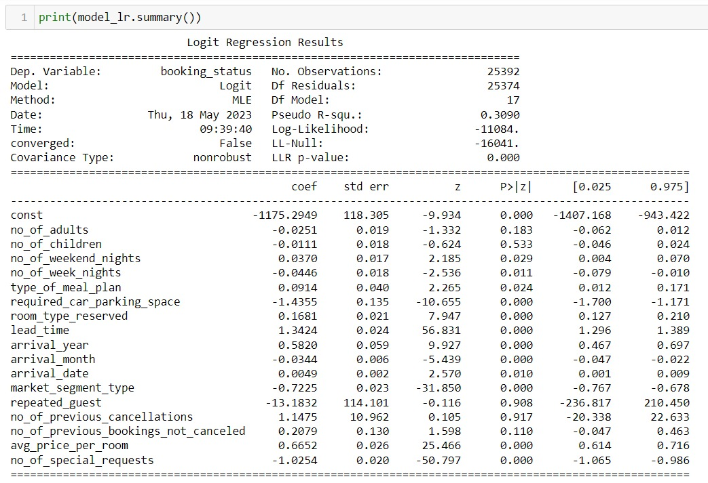
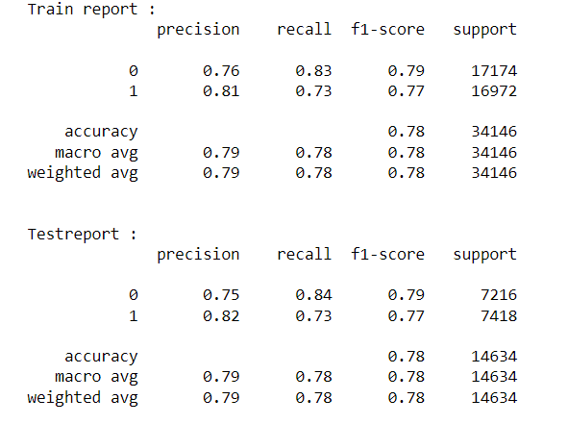
BASE ML MODELS FOR CLASSIFICATION
Notes:
Insignificant Variable basis P val: no of children , no of adult, repeated guest, no of prev cancellation, no of prev booking not cancelled .

Slide 10
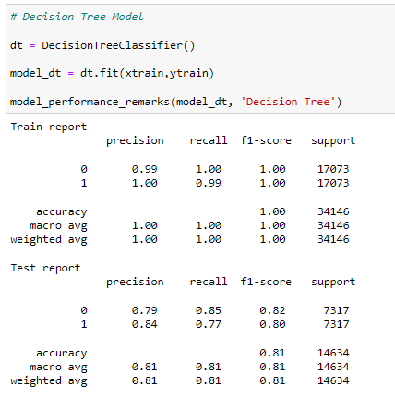
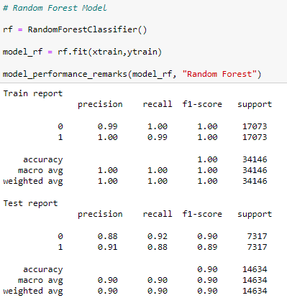
Decision Tree Model Random Forest Model

Slide 11
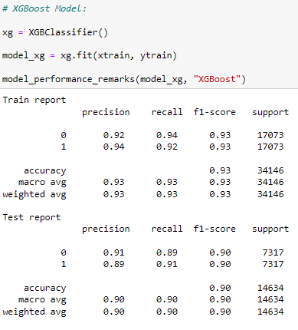
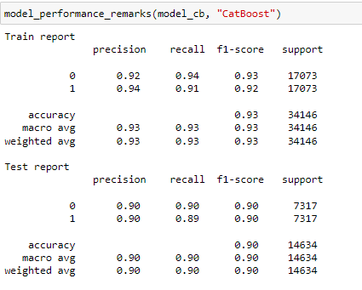
XG Boost Model CAT Boost Model
Notes:
Feature Importance : Top 5 features – Market segment type, no of spl req, required car park, lead time , no of adults.

Slide 12
Business Inference
Valuable insights:
The Hotel industry is season driven, which means the arrival month makes a huge difference in honoring the booking.
One more important consideration that we did not have in our dataset is about the region in which the hotel is present. Based on the type of region(Tourist, non tourist), the prediction will be more appropriate
The purpose of booking also is not available in the dataset , which also has a impact in honoring the prediction
Channel analysis: Analyzing booking channels (online travel agencies, direct bookings, corporate bookings) helps evaluate marketing effectiveness and focus efforts on profitable channels.
Enhancing online presence: Utilize channel analysis to enhance online presence, optimize distribution strategies, and build partnerships with influential booking platforms.
Predictive models: Historical data enables the development of predictive models for forecasting demand, occupancy rates, and revenue.
Strategic decision-making: Predictive models aid in strategic decision-making, resource planning, and pricing optimization for different seasons
Anticipating customer behavior: Advanced analytics techniques help anticipate customer behavior, identify potential booking cancellations, and mitigate risks.
Improved customer experience: Insights from the dataset enable businesses to optimize operations and improve the overall customer experience.
Increased profitability: Informed decisions based on dataset analysis lead to increased profitability for businesses in the hospitality industry.
Deployment: We deployed the case study and tested the same.
https://harisri08-hotelreservation-app-jx1t2z.streamlit.app/

Slide 13
Thanks!

